Slide 1
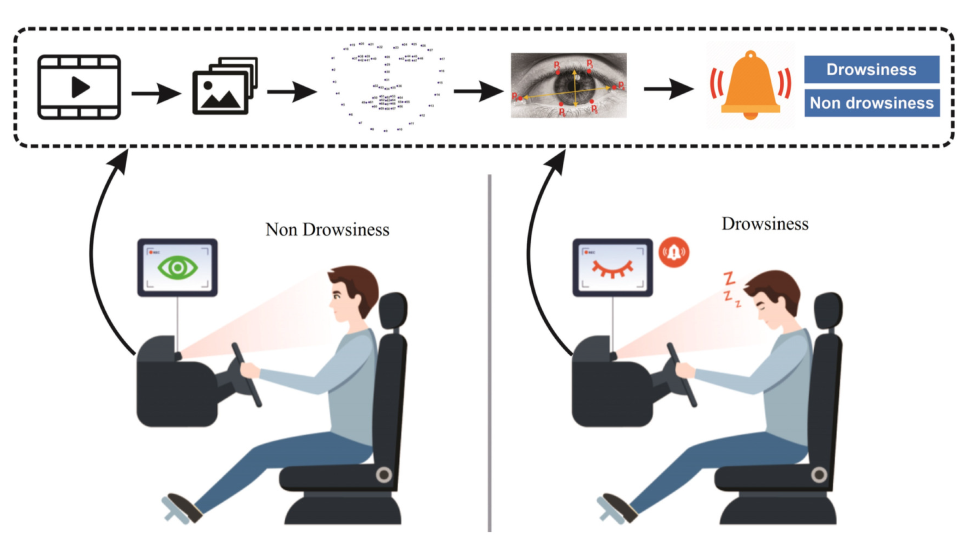
Drowsiness Detection System

Slide 2
INTRODUCTION
Definition: A drowsiness detection system is a technology designed to monitor a driver's level of alertness and detect signs of drowsiness or fatigue.
Importance of Road Safety: Drowsy driving contributes to a significant number of accidents and fatalities on the roads.
Objective: Explore the working principle and applications of drowsiness detection systems in enhancing road safety.

Slide 3
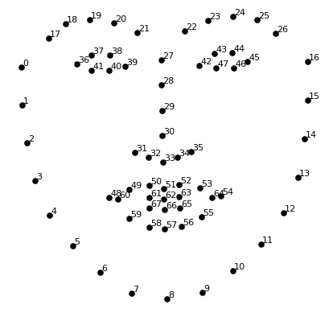
WORKING
36: Coordinates of the left corner of the eye.
37: Coordinates of the upper eyelid's left edge.
38: Coordinates of the upper eyelid's right edge.
39: Coordinates of the right corner of the eye.
40: Coordinates of the lower eyelid's right edge.
41: Coordinates of the lower eyelid's left edge.
68 Face Landmarks

Slide 4
WORKING
Compute Function: This function computes the Euclidean distance between two points.
Blinked Function: This function determines if an eye blinked based on the positions of six landmarks representing the eye. It calculates a ratio of distances between specific pairs of landmarks and compares it against predefined thresholds to determine if a blink occurred.
Formula: The blink ratio is calculated as (up/ 2*down).
Returns 2 if the blink ratio is greater than 0.25, indicating a complete blink.
Returns 1 if the blink ratio is between 0.21 and 0.25, suggesting a partial blink.
Returns 0 if the blink ratio is below 0.21, indicating no blink.

Slide 5
USE
If the driver is found to be sleeping or drowsy, several actions can be taken to mitigate the risks and ensure the safety of the driver, passengers, and other road users.
Alerts and Warnings: The drowsiness detection system can issue audible, visual, or tactile alerts to notify the driver about their drowsy or sleeping state. These alerts can include sounds, vibrations, or messages displayed on the dashboard or instrument cluster.
Voice Commands: The system can provide voice commands or warnings, such as "Please rest and take a break" or "Driver fatigue detected, pull over safely."

